Slide 1
NoSQL Databases
CS220
Slides adapted from
Simon Miner
Gordon College

Slide 2
Start Recording

Slide 3
Attendance Quiz:
Database Architectures
Write your name and the date
Working with a partner:
  Discuss pros and cons of hosting a database on multiple servers
  Describe:
    Horizontal fragmentation
    Vertical fragmentation
    Replication
Notes:
Horizontal fragmentation: Store different records (rows) at distinct sites
Vertical fragmentation: Store different columns at distinct sites
Replication: Storing the same data at different locations. Improves performance and availability.

Slide 4
Agenda
Emergence of NoSQL
NoSQL Databases
  Graph databases
  Aggregate databases – Key-value, document, and column family
Related Topics
  Distributed Databases and Consistency with NoSQL
  Map-Reduce Pattern
  Schema Migrations
  Polyglot Persistence
  When (not) to use NoSQL

Slide 5
Emergence of NoSQL

Slide 6
Pros and Cons of Relational Databases
Advantages
  Data persistence
  Concurrency – ACID, transactions, etc.
  Integration across multiple applications
  (Mostly) Standard Model – tables and SQL
Disadvantages
  Impedance mismatch
  Integration databases vs. application databases
  Older RDBMSs were not designed for clustering
    Counterexamples: Distributed RDBMSs like CockroachDB, Google F1, etc.
Notes:
Relational databases have been in heavy use for ~40 years
Need to look at the (relative) shortcomings of relational databases to understand the impetus for NoSQL
Other challengers have come and gone – object databases, XML databases

Slide 7
Impedance Mismatch
Different representations of data when it is in the RDBMS vs. in memory
  In-memory data structures use lists, dictionaries, nested and hierarchical data structures
  Relational database only stores atomic values
    No lists or nested records
  Translating between these representations can be costly and confusing
    Limits the productivity of application developers
Object-relational mapping (ORM) can help with this
  Abstraction can lead to neglect of query performance tuning
Caveat: Modern RDBMS's support JSON data

Slide 8
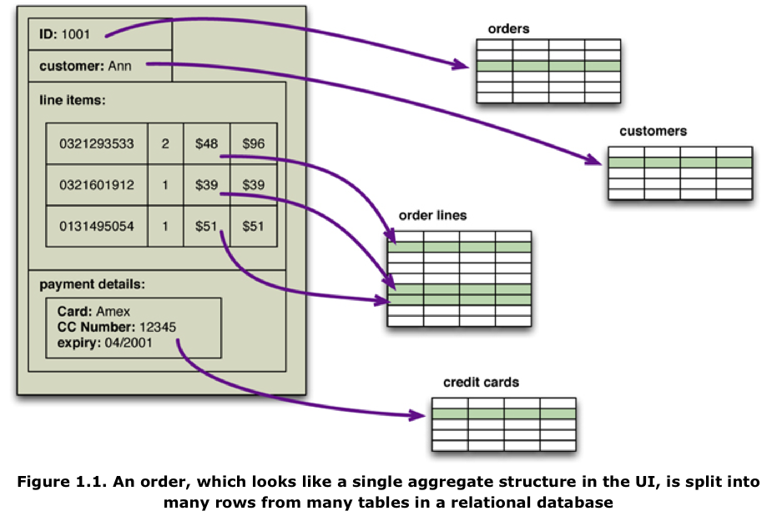
Impedance Mismatch Example
Notes:
Impedance mismatch example: on an e-commerce website, an order is made up of numerous components that do not map easily from memory to a relational database

Slide 9
Integration vs. Application Databases
Integration databases support multiple applications
  Can be problematic if the applications have very different needs and are maintained by separate teams
    Who maintains the database?
SQL can be limiting as the only shared layer
  Web services have become a more flexible alternative
Application databases are simpler to deal with
  Application is the only thing using the database
    No connections from external sources
  Security and flexibility decrease in priority
Notes:
With a web service, developers agree once on a given API, and after that, the underlying data structure can change without different teams needing to know about it
Example: In 2002, Jeff Bezos issued an edict that all logic at Amazon needed to be encapsulated in web services
When you load a page at Amazon’s site, there are dozens to hundreds of web service calls that assemble the content

Slide 10
The Need for Clusters
The Internet created the need to store and process huge amounts of data
Traditionally, relational databases could scale “up” (bigger machine) , but not “out” (many machines) as well
  Disk subsystem was a single point of failure
  Distributing/fragmenting/sharding data was complicated
  High licensing costs for many database machines and CPUs
Large web companies began developing their own alternative technologies to deal with these issues
  Google’s BigTable and Amazon’s Dynamo
  Issues addressed by these solutions have become relevant to smaller companies wanting to capture and analyze lots of data
Notes:
By no means a “nail in the coffin” of relational databases: see distributed RDBMSs

Slide 11
The Emergence of NoSQL
Ironically, the term “NoSQL” was first used as a name for an open source relational database released in the late 1990’s
Term as it is used today was a hastily-chosen Twitter hash tag for a conference meet-up on the topic in 2009
No official general definition for NoSQL, but common characteristics include:
  Does not use the relational model (mostly)
  Driven by the need to run on clusters
  Built for the need to run 21st century web properties
  Schema-less
More of a movement than a technology
  Relational databases are not going away
  Polyglot persistence – use the type of data store most appropriate for the situation
Notes:
NoSQL is still very young, but it has merit as an alternative or compliment to relational databases

Slide 12
Future: Which DBMS should you choose for your application?
Anecdote: "Relational databases can't scale as well as NoSQL"
  Reality: Most applications don't need to scale beyond a single server. For applications that do, see CockroachDB, Google Spanner, etc.
Anecdote: "Relational databases are harder to use than NoSQL"
  Reality: Although relational DBs require you to define your schema, this will probably save you effort in the long-term. A defined schema also allows tools like the Django admin interface.
    If you wanted to, you could just store JSON in a relational DB…
Knowledge of different DBMSs is necessary for an informed choice. My opinion: some NoSQL products often meet a genuine need (e.g., Redis for caching, graph DBs for complex graph queries), while other products are usually not the best choice.
Notes:
No easy "always use X". Every DBMS has different pros and cons.
In my opinion, there are some "usually don't use Y" DBMSs…

Slide 13
Graph Databases

Slide 14
Graph Databases
Excel at modeling relationships between entities
Terminology
  Node – an entity or record in the database
  Edge – a directed relationship connecting two entities
    Two nodes can have multiple relationships between them
  Property – attribute on a node or edge
Graphs are queried via traversals
  Traversing multiple nodes and edges is very fast
    Because relationships are determined when data is inserted into the database
  Relationships (edges) are persisted just like nodes
    Not computed at query time (as in relational databases)
Notes:
Neither aggregate nor relational databases are very good at modeling complex relationships between data
“Find all friends of mine over age 30 who like database books written by authors from Boston?”

Slide 15
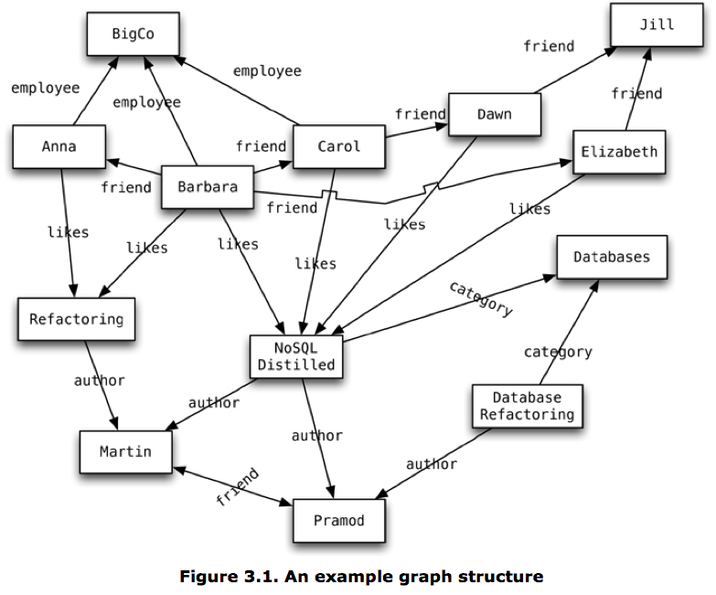
Graph Database Example
Notes:
Discuss structure of graph – companies, employees with friends, books they like, the categories they belong to, and authors who wrote the books
Supports complicated queries that require traversing multiple relationships
Find all the things that both Anna and Barbara like.
Find the books in the Databases category that are written by someone whom a friend of mine likes.
Nodes and edges can include metadata or attributes
Edges can have direction

Slide 16
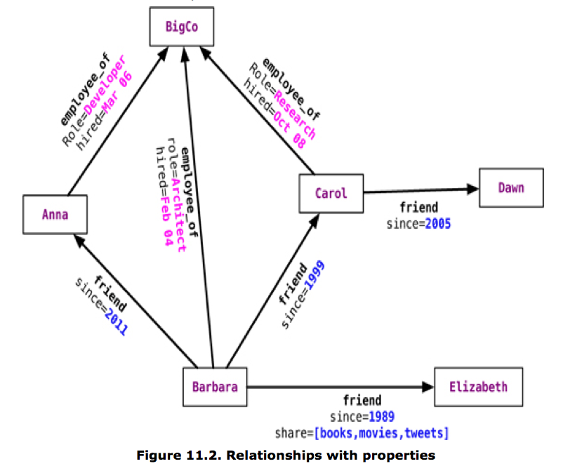
Graph Database Example

Slide 17
Graph Database Features
Transaction support – graph can only be modified within a transaction
  No “dangling relationships” allowed
  Nodes can only be deleted if they have no edges connected to them
Availability via replication
Scaling via sharding is difficult since the graph relies heavily on the relationships between its nodes
  Fragmentation can be done using domain knowledge (i.e. separating relationships by different geographic regions, categories, time periods, etc. – factors don’t get traversed much)
    Traversal across shards is very expensive

Slide 18
Interacting with Graph Databases
Web services / REST APIs exposed by the database
Language-specific libraries provided by the database vendor or community
  // Find the names of people who like NoSQL Distilled
  Node nosqlDistilled = nodeIndex.get("name",
  "NoSQL Distilled").getSingle();
  relationships = nosqlDistilled.getRelationships(INCOMING, LIKES);
  for (Relationship relationship : relationships) {
  likesNoSQLDistilled.add(relationship.getStartNode());
  }
Query languages – allow for expression of complex queries on the graph
  Gremlin with Blueprints (JDBC-like) database connectors
  Cypher (for neo4j)
Notes:
Language library is a Java example of accessing a neo4j database
Look up NoSQL Distilled book by its name – which is an indexed attribute on the graph nodes

Slide 19
Graph Database Query Language Example
A “select” statement in Cypher
  START beginingNode = (beginning node specification)
  MATCH (relationship, pattern matches)
  WHERE (filtering condition: on data in nodes and relationships)
  RETURN (What to return: nodes, relationships, properties)
  ORDER BY (properties to order by)
  SKIP (nodes to skip from top)
  LIMIT (limit results)
Find the names and locations of Barbara’s friends
  Cypher
  START barbara = node:nodeIndex(name = "Barbara")
  MATCH (barbara)-[:FRIEND]->(friend_node)
  RETURN friend_node.name,friend_node.location
  Gremlin
  g = new Neo4jGraph(‘/path/to/graph/db’)
  barbara = g.idx(T,v)[[name:’Barbara’]]
  friends = barbara.out(‘friend’).map
Notes:
The Gremlin language is written in Groovy, which is a superset of Java

Slide 20
Using Graph Databases
Use graph databases for…
  Connected data in link-rich domain (i.e. friends, colleagues, employees, customers, etc.)
  Routing or dispatch applications with location data (i.e. maps, directions, distances)
  Recommendation engines (i.e. for products, dating services, etc.)
Don’t use graph databases for…
  Applications where many or all data entities need to be updated at once or frequently
  Data that needs lots of partitioning

Slide 21
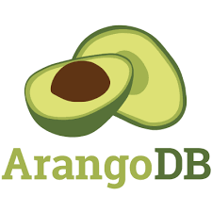

Popular Graph Databases
Supports graph, key-value, and document-based access patterns
https://en.wikipedia.org/wiki/Graph_database#List_of_graph_databases

Slide 22
Aggregate Data Models

Slide 23
Aggregate Data Models
Aggregate – a collection of related objects treated as a unit
  Particularly for data manipulation and consistency management
Aggregate-oriented database – a database comprised of aggregate data structures
  Supports atomic manipulation of a single aggregate at a time
  Makes it simple to scale out across clusters
    Aggregates make natural units for replication and fragmentation/sharding
  Aggregates match up nicely with in-memory data structures
  Use a key or ID to look up an aggregate record
An aggregate-ignorant data model has no concept of how its components can aggregate together
  Can efficiently support query data in multiple ways, but makes it more challenging to scale across clusters
  For example: relational databases and graph databases
Notes:
Aggregate databases are good at supporting the same kinds of queries executed many times (as in an application database). They are not as good at querying data across aggregate records.
Many (but not all) NoSQL databases are aggregate-oriented

Slide 24
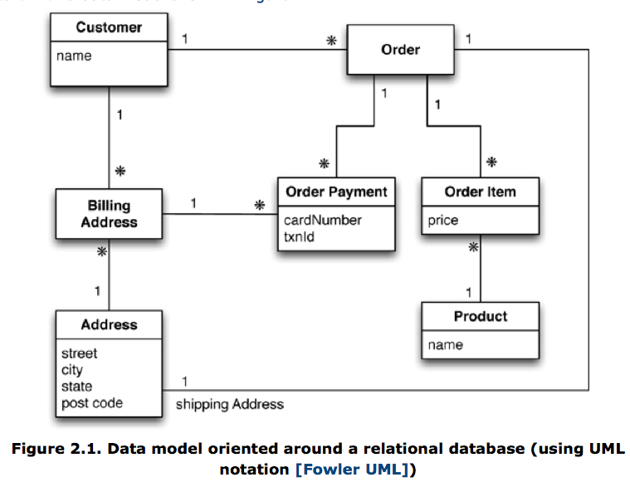
Aggregate Database Example: An Initial Relational Model
Notes:
Relational database for an e-commerce system
Note how many other entities reference the address table
Customer via billing address entity
Order payment via billing address entity
Order via shipping address relationship
A single entity used to house many addresses and avoid duplicates

Slide 25
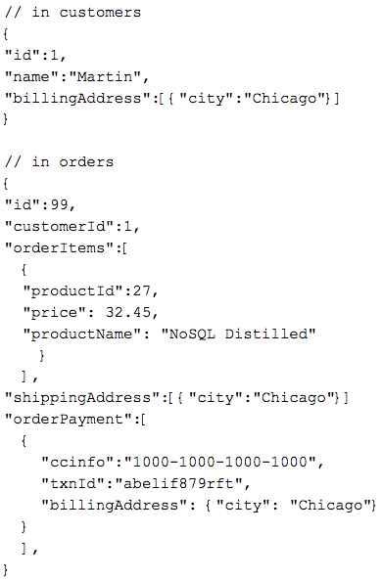
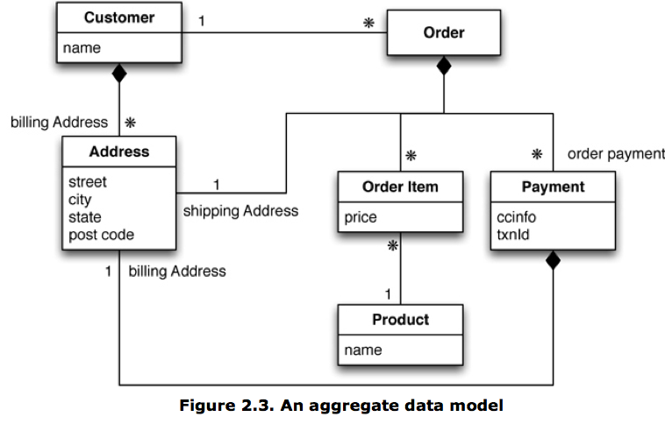
Aggregate Database Example: An Aggregate Data Model
Notes:
Black diamond operator means “composed of”
Two aggregates – customer and order
Customer aggregate includes a list of addresses
Order aggregate includes order items, a shipping address, and a one or more payments
Payment includes a billing address
3 copies of the same address record appear in the JSON structure (for customer, order shipping, and payment billing)
In a relational database, these would probably be a single row in the address table
Relationship between customers and orders – JSON shows that each order has a customerID field (like a foreign key)
Similar relationship between order items and products (which would probably include more detail in their own records)
Repetition of product name minimizes the number of aggregates needed for a single query
This denormalization is common in aggregate databases

Slide 26
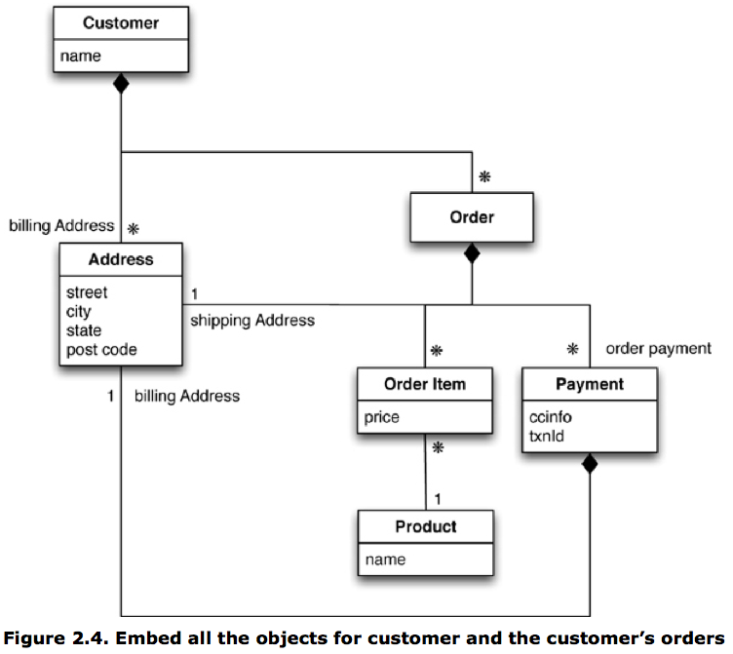
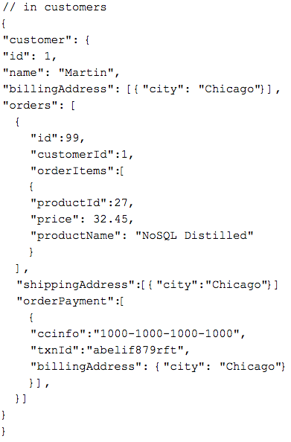
Aggregate Database Example: Another Aggregate Model
Notes:
Single aggregate – customer which now includes order records
JSON shows this nested record structure – now a customer can easily access data on all of its orders
Relationship between customers and orders is technically one-to-many, but in practice “one-to-few” since the order count for a given customer will be fairly limited, making it feasible to store all orders within their associated customer record
The structure you choose should depend upon how you intend to access the data
If all of a customer’s orders at once, this model works well
If a single order at a time (across customers), the previous model works well

Slide 27
Aggregate-Oriented Databases
Key-value databases
  Stores data that is opaque to the database
    The database cannot see the structure of records, just has a key to access a record
    Application needs to deal with this
  Allows flexibility regarding what is stored (i.e. text or binary data)
Document databases
  Stores data whose structure is visible to the database
    Imposes limitations on what can be stored
    Allows more flexible access to data (i.e. partial records) via querying
Both key-value and document databases consist of aggregate records accessed by ID values
Column-family databases
  Two levels of access to aggregates (and hence, two pars to the “key” to access an aggregate’s data)
    ID – to look up aggregate record
    Column name – either a label for a value (name) or a key to a list entry (order id)
  Columns are grouped into column families

Slide 28
Relationships in Aggregate Databases
Aggregates contain ID attributes to related aggregates
  Require multiple database accesses to traverse relationships
    One to lookup ID(s) of related aggregate(s) in main aggregate
    One to retrieve each of the related aggregates
  Many NoSQL databases provide mechanisms to make relationships visible to the database (to make link-walking easier)
Atomicity is limited to each aggregate, so updates to relationships require the application to maintain consistency (which could be difficult!)
Aggregate databases become awkward when it is necessary to navigate around many aggregates
Graph databases – small nodes connected by many edges
  Make navigating complex relationships fast, since linking nodes is done at time of insert, and not at query time
Notes:
Link walking indexes can be useful, but they are slower because they do not access aggregate records by key

Slide 29
Data Management Scale with Aggregate Databases
Different aggregate data models have differing data management capabilities
  Key-value databases
    Opaque data store
    Almost no database involvement with managing data
  Document databases
    Transparent data store
    Some facilities in databases to administer data (partial record queries, indexes)
  Column family databases
    Transparent data store and dynamic schema
    Data management constructs (key spaces, query languages)
  Relational databases
    Static uniform schema
    Database manages the data (integrity constraints, security, etc.)
Notes:
Draw data management scale from application to database -- key-value at one end to RDBMS at other end

Slide 30
Schema-less Databases
Common to many NoSQL databases – also called emergent schemas
Advantages
  No need to predefine data structure
  Good support for non-uniform data
Disadvantages
  Potentially inconsistent names and data types for a single value
    Example: "quantity, Quantity, QUANTITY, qty, count, …" or "5, 5.0, five, V …"
    The database does not enforce these things because it has no knowledge of the implicit schema
  Management of the implicit schema migrates into the application layer
    Failure to do this properly can lead to hard-to-catch bugs (e.g., a bug affecting all customers who registered from Jan 1st 2018 until July 4th 2019)
    Need to look at code to understand what data and structure is present
      No standard location or method for implementing the logic to do this
    What do you do if multiple applications need access to the database?
Notes:
Non-uniform data example – item in an RPG database, has basic properties (name), but then custom attributes based on type (weapon, armor)
In a relational database, this leads to sparsely populated columns or tables
In NoSQL, only those attributes that apply are included

Slide 31
Key-Value Databases

Slide 32
Key-Value Databases
Key-value store is a simple hash table
  Records access via key (ID)
    Akin to a primary key for relational database records
    Quickest (or only) way to access a record
  Values can be of any type -- database does not care
    Like blob data type in relational database
  Bucket – namespace used to segment keys
    Shows up as (sometimes implicit) prefix or suffix to key
Operations
  Get a value for a given key
  Set (or overwrite or append) a value for a given key
  Delete a key and its associated value

Slide 33
Key-Value Database Features
Consistency only applies in the context of a single key/value pair
  Need strategy to handle distributed key-value pairs – i.e. newest write wins, all writes reported and client resolves the conflict
No ACID transactions because of performance requirements over distributed cluster
  Weaker transaction consistency can be asserted by requiring that a certain number of nodes (quorum) get the write
Scale by both fragmentation and replication
  Shard by key values (using a uniform function)
  Replicas should be available in case a shard fails
    Otherwise all reads and writes to the unavailable shard fail

Slide 34
Interacting with Key-Value Databases
Applications can only query by key, not by values in the data
Design of key is important
  Must be unique across the entire database
  Bucket can provide an implicit top-level namespace
How and what data gets stored is managed entirely at the application level
  Single key for related data structures
    Key incorporates identification data (i.e. user_<sessionID>)
      Data can include various nested data structures (i.e. user data including session, profile, cart info)
    All data is set and retrieved at once
  Different kinds of aggregates all stored in one bucket
    Increases chance of key conflicts (i.e. profile and session data with same ID)
  Multiple keys for related data structures
    Key incorporates name of object being stored (i.e. user_<sessionID>_profile
    Multiple targeted fetches needed to retrieve related data
    Decreases chance of key conflicts (aggregates have their own specific namespaces)
  Expiration times can be assigned to key-value pairs (good for storing transient data)
Notes:
Key design factors
Can (part of) the key be generated by some algorithm (i.e. counter, random unique value)?
Can (part of) the key be specified by the user (i.e. email address)?
Can the key incorporate timestamps or other data derived outside the database?
How specific should the key be in relation to the data stored it its value?
How much information should it include in light of the system’s maximum key length?

Slide 35
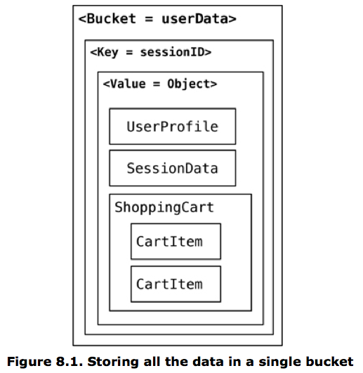
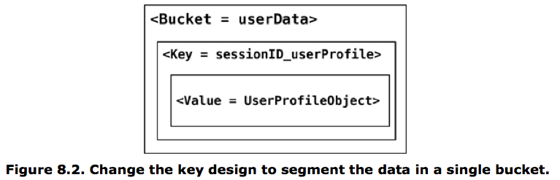
Key-Value Aggregate Examples
Notes:
First example – all data stored in nested data structures within the sessionID key value
Second example – data is segmented by data type in key (i.e. user profile)

Slide 36
Using Key-Value Databases
Use key-value databases for…
  Data accessed via a unique key (i.e., page id, session, user profile, shopping cart, etc.)
    Caching
    Transient data
Don’t use key-value databases for…
  Relationships among data
  Multi-operation transactions
  Querying by data (value instead of key)
  Operations on sets of records
Notes:
* Example: using redis or memcached for caching static pages, expensive API results, etc.

Slide 37


Popular Key-Value Databases
Memcached
Notes:
Explain downsides: everything is stored in memory! Can be saved to disk at intervals.
Ask class – why wouldn't you want to store your application's main data in just memory?
Ask class – why not do caching in a relational database?

Slide 38
Start Recording

Slide 39
Attendance Quiz:
Aggregate Data Models
Write your name and the date
Working with a partner, draw one or more aggregates to represent the following information:
  Alice has borrowed a book, "Through the Looking-Glass," by Lewis Carroll (ISBN: 1949460894, copy number 2, accession number 4837). The book is due back on December 1st, 2021.

Slide 40
Review Homework 10

Slide 41
Document Databases
Notes:
RESUME HERE

Slide 42
Document Databases
Store of documents with keys to access them
  Similar to key-value databases except…
  Can see and dynamically manipulate the structure of the documents
    Often structured as JSON (textual) data
    Each document can have its own structure (non-uniform)
  Each document is (automatically) assigned an ID value (_id)
Consistency and transactions apply to single documents
  If this isn't sufficient for your application, then document databases are a poor fit
Replication and sharding are by document
Queries to documents can be formatted as JSON
  Able to return partial documents
Notes:
The _id value can be manually as well as automatically set
Documents of similar types are stored in collections (analogous to tables in RDBMS, except that columns can be dynamically created as needed)
Limitations of multi-document transactions in MongoDB:
https://severalnines.com/database-blog/overview-multi-document-acid-transactions-mongodb-and-how-use-them

Slide 43
Document Database Example
// in order collection
{
“customerId”:12345,
“orderId”:67890,
“orderDate:”2012-12-06”,
“items”:[{
“product”:{
“id”:112233,
“name”:”Refactoring”,
“price”:”15.99”
},
“discount”:”10%”
},
{
“product”:{
“id”:223344,
“name”:”NoSQL Distilled”,
“price”:”24.99”
},
“discount”:”3.00”,
“promo-code”:”cybermonday”
},
],
…
}
SQL | Document Database Query
select * from order | db.order.find()
select * from order where customerId = 12345 | db.order.find({ “customerId”:12345 })
select orderId, orderDate from order where customerId = 12345 | db.order.find( {“customerId”:12345}, {“orderId”:1,”orderDate”:1} )
select * from order natural join orderItem natural join product p where p.name like ‘%Refactoring%’ | db.order.find({ “items.product.name”: ”/Refactoring/” })
Notes:
Note that structure of order items varies between item sub-records
Note that document database queries are formatted in JSON, just like the data they manipulate

Slide 44
Using Document Databases
Document databases can be used for…
  Content management or blogging platforms
  Web analytics stores
  E-commerce applications
  Event logging – central store for different kinds of events with various attributes
…but relational databases can be used for many of the same things
Do not use document databases for…
  Transactions across multiple documents (records)
  Ad hoc cross-document queries

Slide 45


Popular Document Databases
Supports graph, key-value, and document-based access patterns

Slide 46
Column Family Databases

Slide 47
Column Family Databases
Structure of data records
  Each record indexed by a key
  Columns grouped into column families (like RDBMS tables)
Additional mechanisms to assist with data management
  Key space – top-level container for a certain kind of data (kind of like a schema in RDBMS)
    Configuration parameters and operations can apply to a key space
      i.e. number of replicas, data repair operations
    Columns are specified when a key space is created
      Some DBs support adding columns at any time, to only rows they pertain to
Data access
  Get, set, delete operations
  Query language (i.e. CQL – Cassandra Query Language)
Notes:
Also called columnar databases/stores
Example column family data – draw profile record
Columns in profile – name, email
Super columns – addresses comprised of street, city, state, and zip
Super column families – addresses comprised of billing and shipping addresses
Newsletter subscription column family – one column for each newsletter, contains boolean value indicating subscription

Slide 48
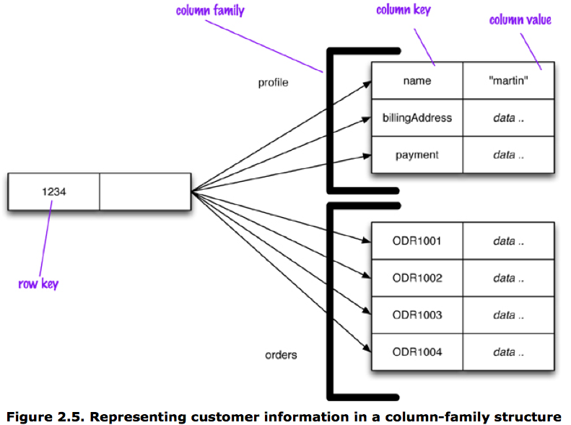
Column-Family Database Example
Notes:
Row accessed by row key “1234”
Columns grouped into families – can be joined together to get the whole row
Profile – data about the customer – get( 1234, ‘name’ ) to fetch customer name
Orders – order history data keyed by order id – get( 1234, “ODR1001’ ) to fetch a specific order
Wide vs. skinny rows -- usually a column-family uses one or the other
Wide rows have many (hundreds or thousands) of sparsely populated columns, allows column-family to define a column sort order
Skinny rows have a few heavily populated columns

Slide 49
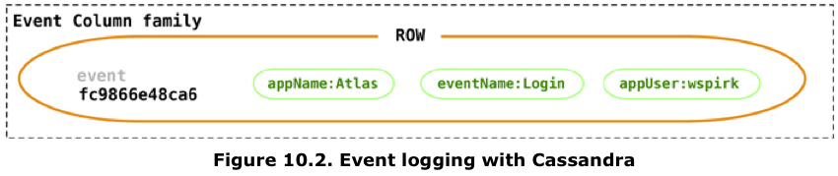
Column Family Database Example
CREATE COLUMNFAMILY Customer (
KEY varchar PRIMARY KEY,
name varchar,
city varchar,
web varchar);
INSERT INTO Customer (KEY,name,city,web)
VALUES ('mfowler',
'Martin Fowler',
'Boston',
'www.martinfowler.com');
SELECT * FROM Customer;
SELECT name,web FROM Customer WHERE city='Boston’
Notes:
Example column family key store layout
CQL examples
Look like SQL
Insert statement could have arbitrary number of new or existing column/value pairs

Slide 50
Storage of a Row-Oriented Database
One block
One row
id | email | salary | id | email | salary | …
Consider: SELECT salary FROM info WHERE email = a@gmail.com
Consider a query including: sum(salary)
Notes:
Each row is stored one after the other on disk. Typically, you're getting all the data from a row, and potentially nearby rows, with a single block read from disk. Of course, if a row is big enough, it might not fit on a single block.
Imagine this query: (click)
Suppose we have no index on email, so a sequential table scan is needed.

Slide 51
Storage of a Column-Oriented Database
One block
One key-value pair
id | email | id | email | id | email | …
One block
One key-value pair
id | salary | id | salary | id | salary | …
Consider: SELECT salary FROM info WHERE email = a@gmail.com
Consider a query including: sum(salary)
Notes:
Columns values are stored one after the other on disk. Makes it easier to get all the salaries, but makes it harder to get all the information about a particular person.

Slide 52
Using Column Family Databases
Consider column family databases when you know the access pattern of. Perhaps for:
  OnLine Analytical Processing: OLAP (e.g., event logging and analysis)
  Counters
  Content management and blogging platforms (e.g., running medium.com, tumblr.com, etc.)
    Less compelling for hosting a single blog
Do not use column family databases…
  When the data's access pattern(s) should be flexible
    E.g., systems requiring ad-hoc aggregate queries, or which might need to support such queries in the future. Scalability is dependent on knowledge of data access patterns.
  For systems requiring ACID transactions
  OnLine Transaction Processing: OLTP (e.g., financial transactions)
Notes:
Columns can be created to keep track of numeric sequences – the next value in the counter column is the next value in the sequence
Expiring data?
See also: https://www.youtube.com/watch?v=Vw1fCeD06YI

Slide 53



Popular Column Family Databases
Open Source
Cloud Services
Google Cloud Bigtable
Amazon DynamoDB
Time Series
InfluxDB

Slide 54
NoSQL Design Activity

Slide 55
NoSQL Design Activity
Working with your project team:
Identify a NoSQL DB that might serve a purpose for your application. Describe how you might use it, and the pros and cons of using it in combination with or instead of a RDBMs:
  Key-value store: think about key design and level
  Document database: think about keys and nested aggregates
  Column family database: think about column families
  Graph database: think about nodes for each entity, with relationships of various types connecting them

Slide 56
Related Issues

Slide 57
Distribution Models
Single server – simplest model, everything on one machine (or node)
Sharding (fragmentation) – storing data (aggregates) across multiple nodes
  Auto-sharding -- some databases handle the logistics of sharding so that the application does not have to
Replication – duplicate data (aggregates) over multiple nodes
  Primary-standby (master-slave) replication – one primary node responsible for updates, one or more standby nodes support reads
  Peer-to-peer (multi-master) replication
    Each node does reads and writes, and communicates its changes to other nodes
      Eliminates any one master as a single point of failure
    Drawbacks include complex synchronization system and inconsistency issues (e.g., write-write conflicts, when two users update the same data item on separate nodes)
Notes:
Auto-sharding – set up a master node, and let it know about a bunch of slave nodes – it handles data distribution
Sharding and replication can be combined
Sharding with master-slave replication – multiple masters, but each data item (aggregate) only has a single master
Sharding with peer-to-peer replication

Slide 58
Review: ACID
Atomicity – either all of the transaction completes, or none of it completes
  If any part of the transaction fails, all effects of it must be removed from the database
Consistency – database ends the transaction in a consistent state (provided it started that way)
Isolation – concurrently executing transactions must be unaware of each other (as if they ran serially)
  It should look to one as if the other has not started or has already completed
Durability – a transaction’s effects must persist in the database after it completes
Notes:
Technically, ACID's "Consistency" is a bit different than CAP's "Consistency," but they are related.

Slide 59
Two Forms of Consistency
Update consistency – ensuring serial database changes
  Pessimistic approach – prevents conflicts from occurring (i.e. locking)
  Optimistic approach – detects conflicts and sorts them out (i.e. validation)
    Conditional update – just before update, check to see if the value has changed since last read
    Write-write conflict resolution – automatically or manually merge the updates
  Trade-off between safety and “liveness” (responsiveness)
Read consistency – ensuring users read the same value for data at a given time
  Logical consistency vs. replication consistency
  Sticky sessions (session affinity) – assign a session to a given database node for all of its work to ensure read-your-writes consistency
Notes:
Logical consistency – consistent between reads on a single node
Replication consistency – consistency between replicas (eventually happens, but may take a while)
Read-your-writes consistency use case – blog comments; write a comment and refresh to see it, but it may not be there if data is served from a different node which has not yet received the update

Slide 60
CAP Theorem
Pick two of these three:
  Consistency: ensure update consistency (serial database changes), and read consistency (data becomes visible to all readers simultaneously)
  Availability: if you can talk to a node, you can read and write
  Partition tolerance: cluster can continue operating even if a network fault divides it into multiple isolated partitions
For distributed systems it's "pick one," because partitions can happen to any distributed system
  If you have just one server, it cannot be partitioned, so you can get both consistency and availability

Slide 61
CAP Explained
To continue operating despite a network partition (partition tolerance), we need to trade off consistency of data vs. availability
    If we want to support writes (availability) while the partitions cannot communicate, their data will become inconsistent
    If we want to keep the data in both partitions consistent, we cannot continue servicing requests

Slide 62
Diluting ACID:
Relaxed Consistency
If a network partition occurs, suppose we choose availability over consistency. For example:
  A user's shopping cart becomes unavailable, so a new cart is created. At checkout, user is prompted to merge carts.
  Allow two users to book a flight/hotel/etc. at the same time. It might be okay if there is an overbooking if extra seats/rooms/etc. can be made available.
Counterpoint: supporting relaxed consistency requires complex application logic. Fast recovery from partitions (less than 10 seconds) can ensure consistency, while having high availability.
  Further reading: The Limits of the CAP Theorem

Slide 63
Diluting ACID:
Relaxed Durability
Replication durability: what happens if primary node receives an update, but it cannot communicate with a standby node?
  Not necessary to communicate with all standbys to preserve strong durability; just a large enough quorum
But what if you are willing to sacrifice durability?
  You can achieve higher performance by writing to disk less frequently
  Perhaps a good choice for:
    Telemetry (e.g., performance statistics): you wouldn't want your webpages to hang if the telemetry server went down anyway
    Session data: updated very frequently, and a critical determiner of site responsiveness. Only a little annoying to customers if they lose a few minutes of recent browsing history, etc.

Slide 64
Map-Reduce

Slide 65
Map-Reduce
Design pattern to take advantage of clustered machines to do processing in parallel, while keeping as much work and data as possible local to a single machine
Map function
  Takes a single aggregate record as input
  Outputs a set of relevant key-value pairs (values can be data structures)
  Each instance of the map function is independent from all others, so safely parallelizable
Reduce function
  Takes multiple map outputs with the same key as input
  Summarizes (or reduces) there values to a single output
Map-reduce framework
  Arranges for map function to be applied to pertinent documents on all nodes
  Moves data to the location of the reduce function
  Collects all values for a single pair and calls the reduce function on the key and value collection
  Programmers only need to supply the map and reduce functions

Slide 66
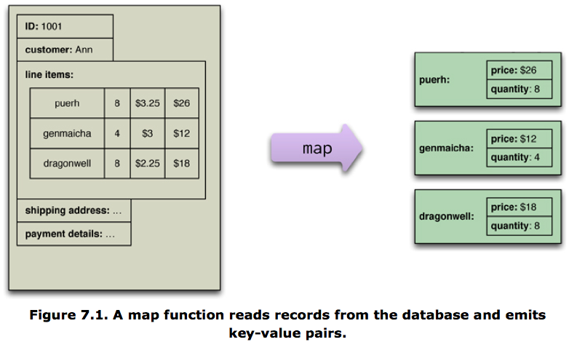
Map-Reduce Example (Map)
Notes:
Example scenario: Find total units sold and sales for last several days of orders
Data is aggregated into orders, which does not lend itself for tallying data like this
Map function processes each order aggregate, extracting price and quantity data from each line item

Slide 67
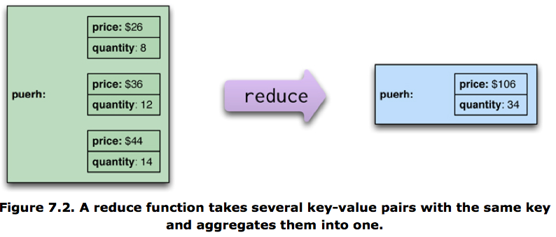
Map-Reduce Example (Reduce)
Notes:
Reduce aggregates key-value pairs from map function, tallying price and quantity data

Slide 68
Partitioning, Combining, and Composing
Reduce operations use values from a single key
  Partitioning by key allows for parallel reduce work
Combinable reducer -- Reducers that have the same form for input and output can be combined into pipelines
  Further improves parallelism and reduces the amount of data to be transferred
Map-reduce compositions
  Can be composed into pipelines in which the output of one reduce is the input to another map
  Can be useful to store result of widely-used map-reduce calculation
    Saved results can sometimes be updated incrementally
      For additive combinable reducers, the existing result can be combined with new data

Slide 69
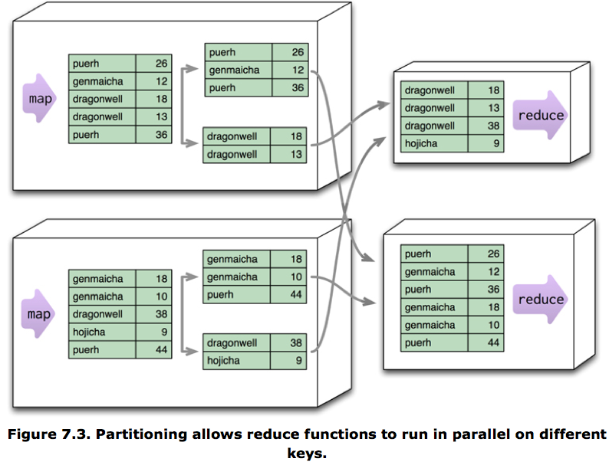
Reduce Partitioning Example
Notes:
Mapped key-value pairs are partitioned by key so that reduce operations can be parallelized
The map boxes group (or partition) duplicate keys together
Partitioned map outputs are sent to a common reduce node, allowing multiple nodes to handle different mapped values

Slide 70
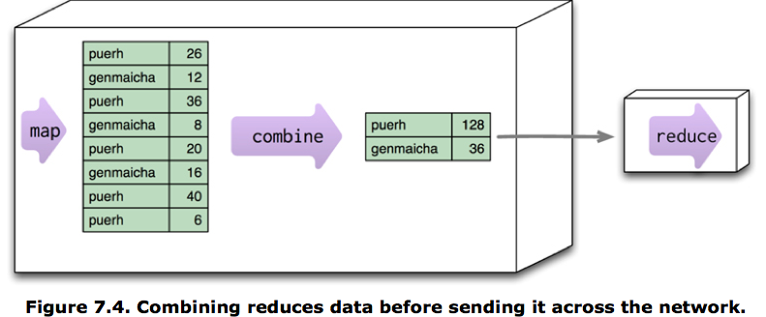
Combinable Reducer Example
Notes:
Combine step can come between the map and reduce, but itself is actually a reduce step
Combinable reducers are desirable, so map operations are sometimes built to accommodate these
If producing a count, a map might emit 1 (which seems obvious), so that the reducer can sum these counts together)
When finding average, map will emit both the sum and count, and reducers may continue to emit these values. The average is not taken until the end

Slide 71
Start Recording

Slide 72
Attendance Quiz:
Project Check In
Write your name and the date
Working with your project team:
  Review the Homework 12 Project Milestone (due Monday, November 29th)
  List the items you still need to complete, and make a plan to divide the work
  Lab tomorrow will be dedicated to working on the projects
    To get the most out of it, come prepared with questions
Notes:
Ask whether the class has any questions about the milestone

Slide 73
Relational vs NoSQL Migrations

Slide 74
Schema Migrations
The structure of data changes regardless of what kind of database it resides in
  System requirements evolve and the supporting database(s) must keep pace
  Transition phase – Period of time in which the old and new schema versions must be maintained in parallel
Challenges
  Avoid downtime of production database(s)
    Difficult to do for large systems as DDL to alter structure often requires database object-level locks
  Ensure database remains usable to all applications during transition phase
    Different applications will integrate the schema changes at different times
    Don’t cause errors
    Don’t corrupt or lose data
  Minimize transition phase
    How can all data be migrated as quickly as possible?
    Does all data need to be migrated?

Slide 75
Schema Changes in Relational Databases
Challenges specific to RDBMS schema changes
  Keep database and applications in sync
    Schema changes applied separately to database and applications
  Schema changes need to be applied in the correct order
  Need to ensure that schema changes can be rolled back if there is a problem
  Schema changes need to be applied to all environments in the same fashion
    Development, test, staging, production
Database migration framework can assist with this
  Logic to execute each schema change is stored in a file which contains a version string
    Scripts to generate initial database or take a “snapshot” of the current structure of an existing database get the initial version (if the database already exists)
  May contain logic to upgrade and downgrade the database to/from its version
  Migration framework is responsible for applying changes up/down to a certain version of the database in the right order
  Integrated into the project build process so it automatically gets executed in various environments when a new version of the application is introduced there
Notes:
Triggers can be useful during transition phase to ensure that both old and new data are correctly populated and maintained
Simon: The one situation I am willing to approve of their use.

Slide 76
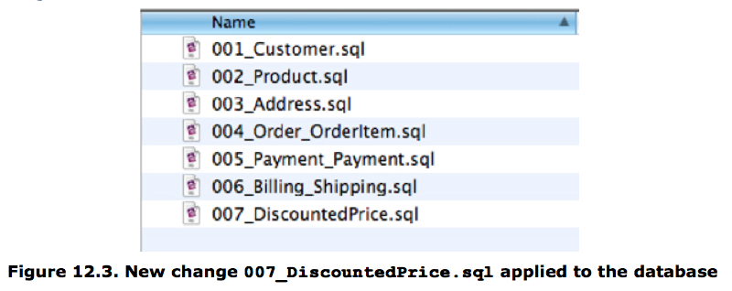
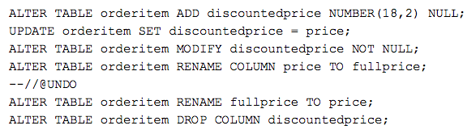
Database Migration Framework Example
Notes:
View of schema migration files along with the contents of 007_DiscountPrice.sql
Suppose the orderitem table has a price column, and we need to add a new column to hold the discount price of an item
Missing commit after update statement in this example (from the book).

Slide 77
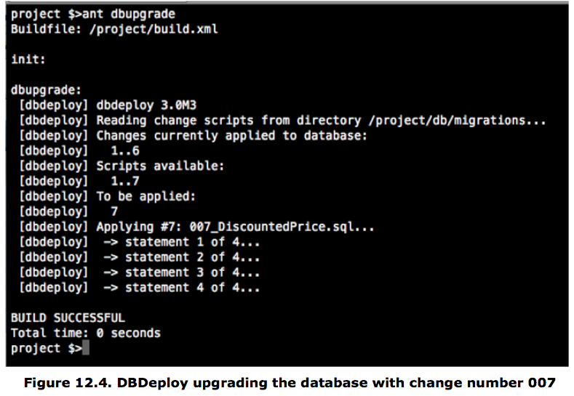
Database Migration Execution Example
Notes:
* Screenshot from DBDeploy migration tool

Slide 78
Schema Changes in a NoSQL Store
Implicit schema – the database may be “schema-less”, but the application still must manage the way data is structured
Incremental migration – read from both schemas and gradually write changes
  Read methodology:
    Read the data from the new / updated field(s)
    If the data is not in the new field(s), read it from the old ones
  Write methodology:
    Write data only to the new field(s)
    Old field may be removed
  Some data may never be migrated
Changes to top-level aggregate structures are more difficult
  Example: make nested order records (inside customers) into top-level aggregates
  Application must work with both old and new structures
Notes:
RESUME HERE, reviewing the first several slides

Slide 79
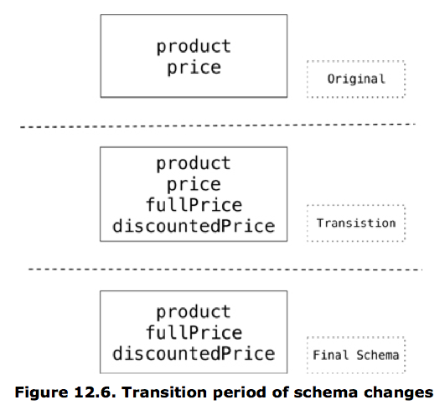
Incremental Migration Example
Notes:
* In actuality, the price fields in records that are not accessed might never go away.

Slide 80
Relational vs NoSQL Migrations
If you are willing to accept a small amount of downtime (to restart your web application), automatic migrations from a framework like Django are a clear win
If downtime is unacceptable, then regardless of your DBMS your application code will need to support data in both the old and new schemas
  With a relational database, after the migration has finished you can remove the code supporting the old data format
  With incremental migrations in NoSQL, you may need to support data in both schemas indefinitely
    Could get messy over the years…

Slide 81
Polyglot Persistence

Slide 82
Polyglot Persistence
Pick the best tool for the job
  Different databases are designed specifically for storing and processing different types of data
Example
  Many e-commerce sites run entirely on a relational database
  Alternatively:
    Keep order processing data in the RDBMS
    Session and shopping cart data could be separated into a key-value store
      More transient data which can be copied to RDBMS once an order is placed
    Customer social data could reside in a graph database
      Designed specifically to optimize traversing relationships between data
Notes:
Simon uses mostly an RDBMS solution
Key/value store for caching
Document database-like store for read-only access to product data (Endeca)
Considering the use of a graph database for recommendation engine data

Slide 83
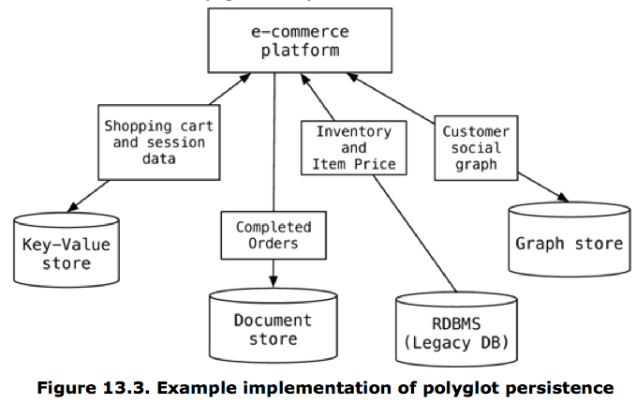
Polyglot Persistence Example
Notes:
Transient shopping cart and session data stored in a key-value database
Structured but potentially non-uniform completed orders data stored in a document database
Longer term and uniform inventory and pricing data stored in a relational database
Relationship-oriented social data (i..e reviews, ratings, “likes”, etc.) stored in a graph database

Slide 84
Web Service Wrappers for Data Stores
Advantages over direct access to data store
  Easier and cleaner to integrate the data store with multiple applications
  Allows database structure to change without needing to update applications that use it
    Potentially even change the database itself
Drawbacks
  Overhead of another layer
  Sometimes a modified web service actually requires changing applications as well
    Reduces this likelihood
Notes:
A well crafted data store is likely to be used by multiple applications

Slide 85
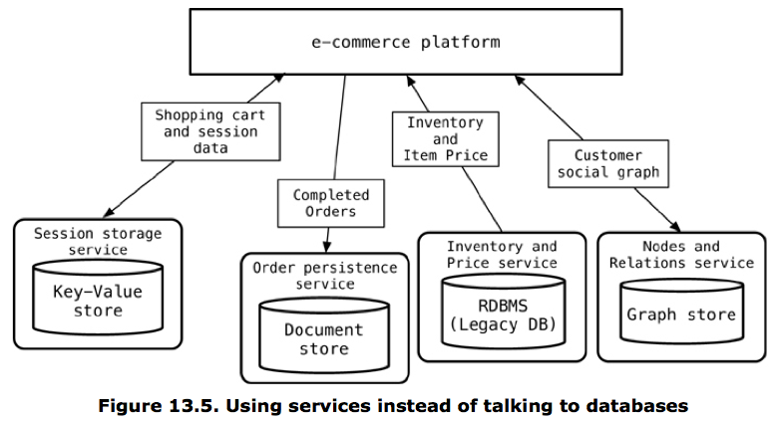
Web Service Wrapper Example
Notes:
Wrapping individual data stores in a web service layer allows for
transparent upgrades to the model
usage by other applications
even replacing the underlying database
New software architecture buzzword - microservices

Slide 86
Which DBMS should you choose?
For a given purpose, do you use relational or NoSQL?

Slide 87
When You Should Use NoSQL
When data has a lot of relationships and needs to support complex queries, use a graph database
When you have weak consistency or durability needs
  For caching, use a key-value store
  For telemetry, use a column family database
    InfluxDB for time series data
    Elasticsearch for log data

Slide 88
When You Might Use NoSQL
Potentially: when your application only needs to support limited access patterns.
  This might be the case if your data is mainly collected or displayed in terms of aggregates
Debatable: if your data includes complex, nested, or hierarchical structures; or if your data is non-uniform
  You could simply de-normalize or store JSON in a relational DB. Can even get better performance this way.
Debatable: programmer productivity
  Easier to prototype with an implicit schema, but much harder to maintain. And again, you could simply use JSON in a relational DB.
Debatable: scalability
  Distributed relational databases (e.g., CockroachDB, Google Spanner, Google F1), etc. show you can get scalability and consistency
Notes:
When the database logic can be encapsulated into an isolated section of the project

Slide 89
When Not to Use NoSQL
When you need consistency (e.g., transferring money between accounts)
When many different applications with different developers/owners will access the data (i.e., integration databases)
  Relational databases support strong security measures at the database level to protect data
  An explicit schema serves as documentation
  However, today web-services are considered a better practice
If you don't have a good reason to use NoSQL
  Relational databases are well-known, mature, and have lots of tools (e.g., the Django admin interface)
  ORM can cut down on impedance mismatch
  Much easier to switch from a well-designed relational schema to an implicit NoSQL schema – potentially impossible to do the reverse

Slide 90
My Recommendations
RDBMS for primary data storage
Key-value stores for caching
Column-family databases for telemetry
Graph databases for data exploration, recommendations, etc.
Generally, avoid document databases
  Much easier to switch from an explicit schema to an implicit schema than vice versa
  Perhaps tempting to rapid-prototype with an implicit schema, but all-too-often, prototypes are deployed to production…

Slide 91
Further Reading
https://www.cockroachlabs.com/docs/stable/cockroachdb-in-comparison.html
https://www.arangodb.com/2018/02/nosql-performance-benchmark-2018-mongodb-postgresql-orientdb-neo4j-arangodb/
Flowchart (linked from schedule)

